Slide 1
Post-transplant care guidelines
Long term care recommendations
nmdp.org

Slide 2
Part 1:
Long-term Screening

Slide 3
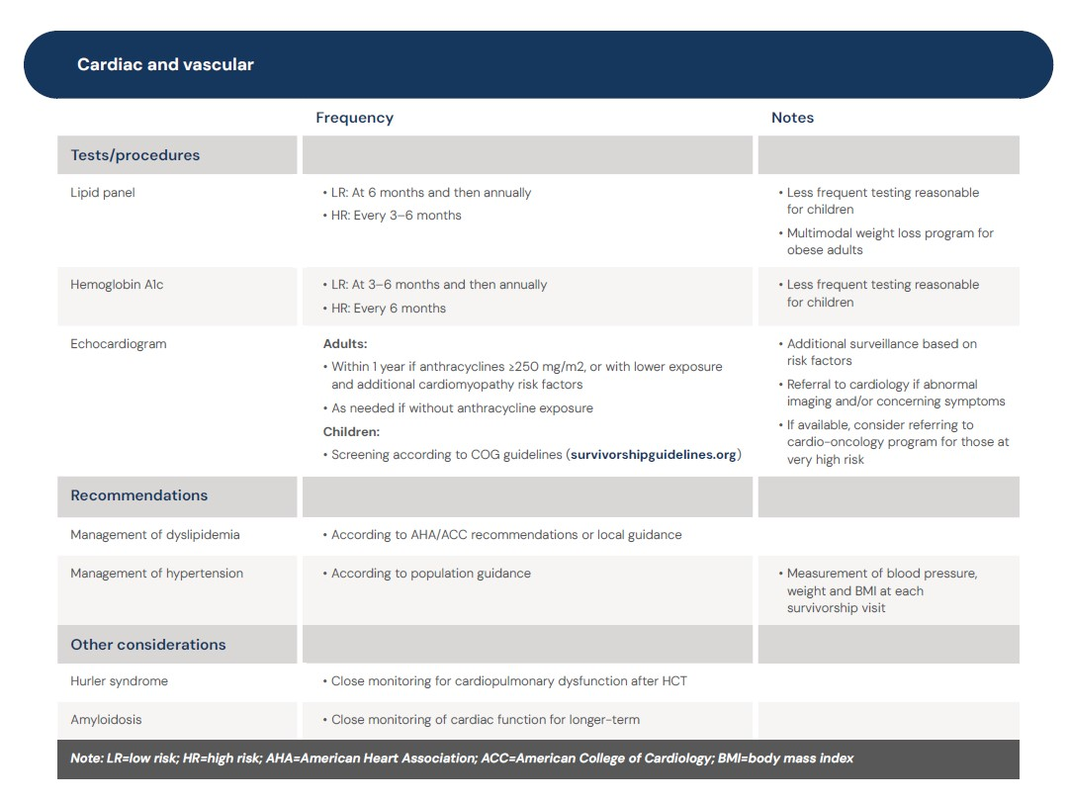

Slide 4
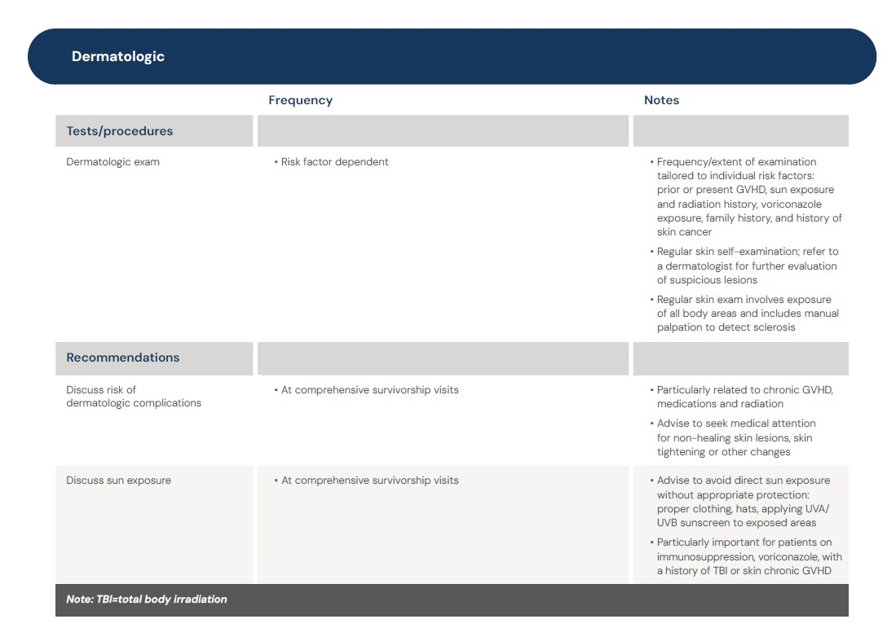

Slide 5
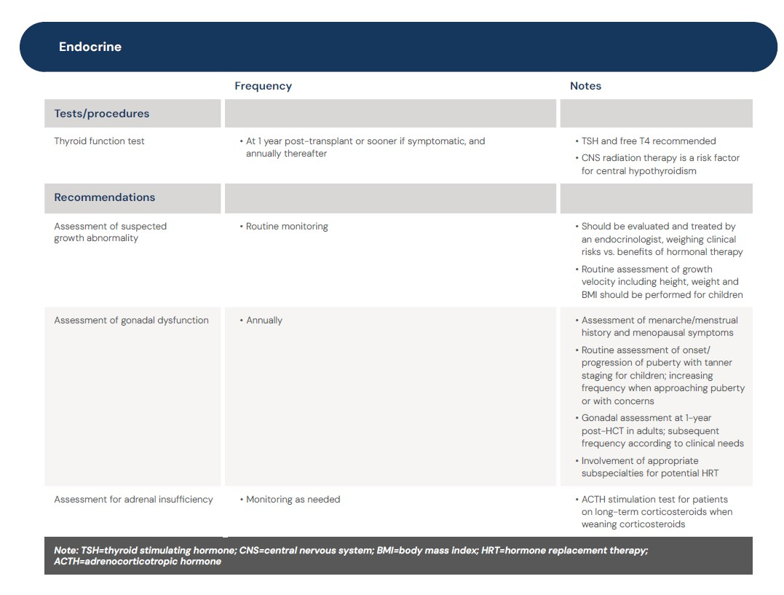

Slide 6
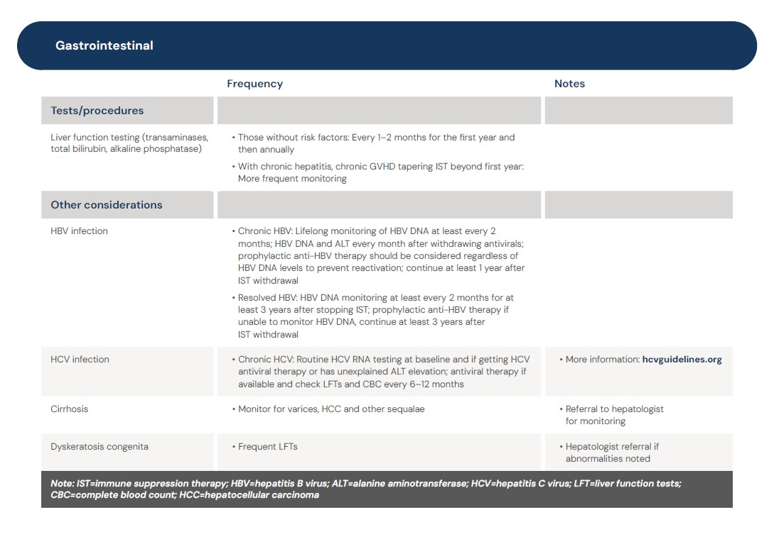

Slide 7
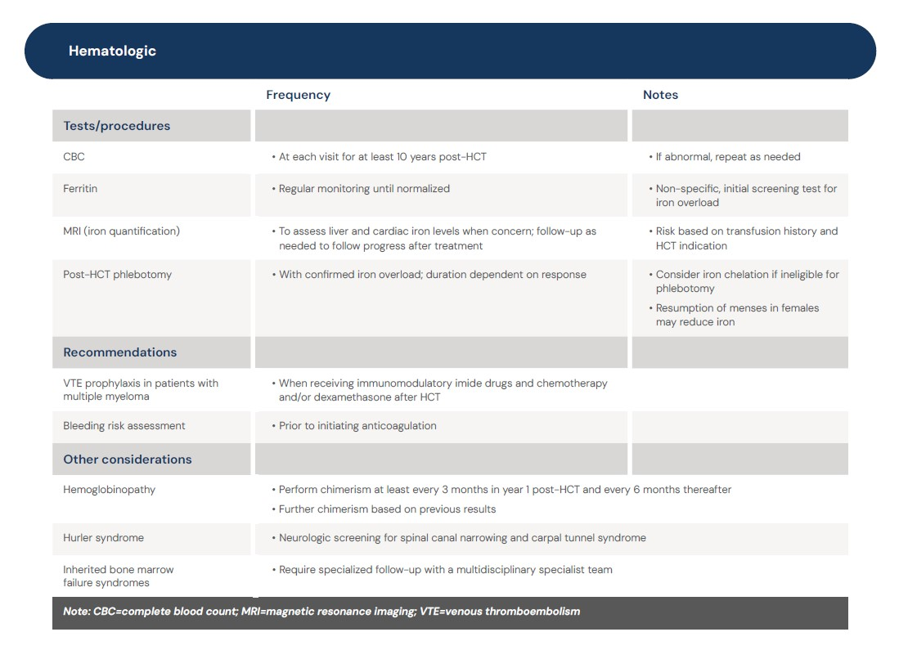

Slide 8
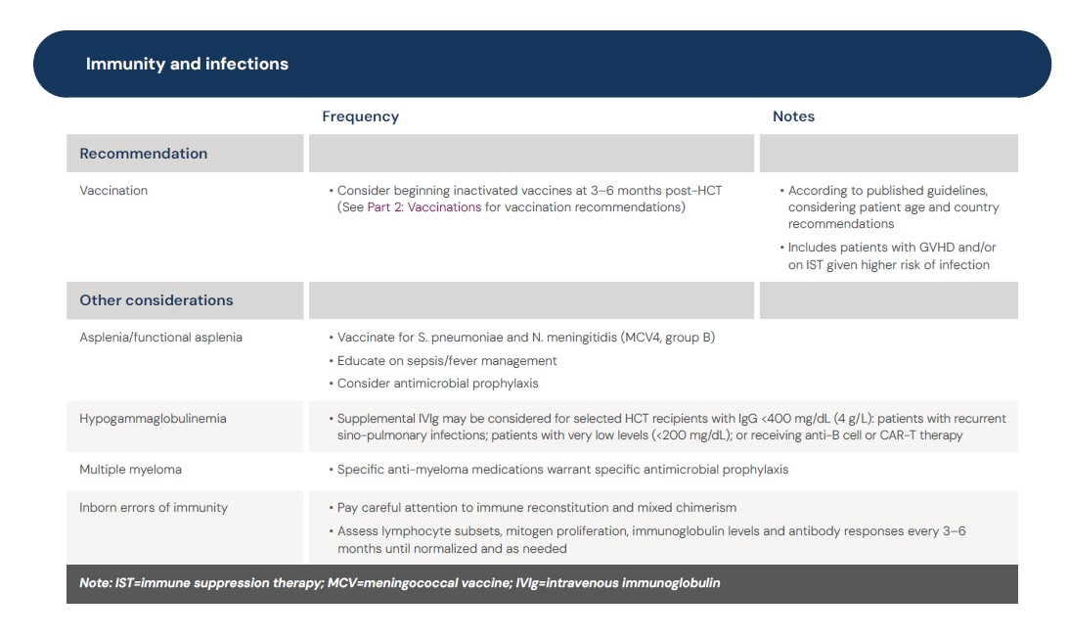

Slide 9
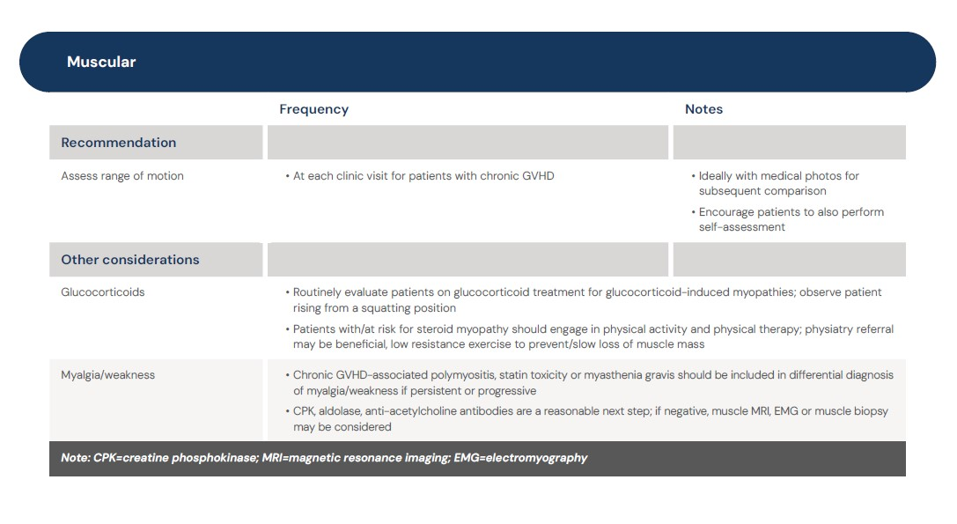

Slide 10
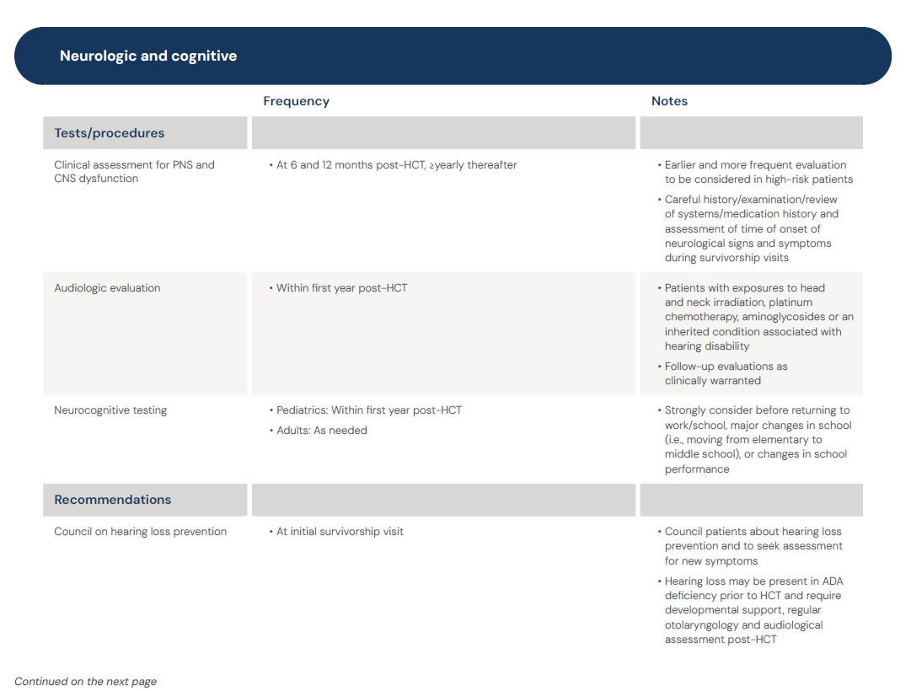

Slide 11
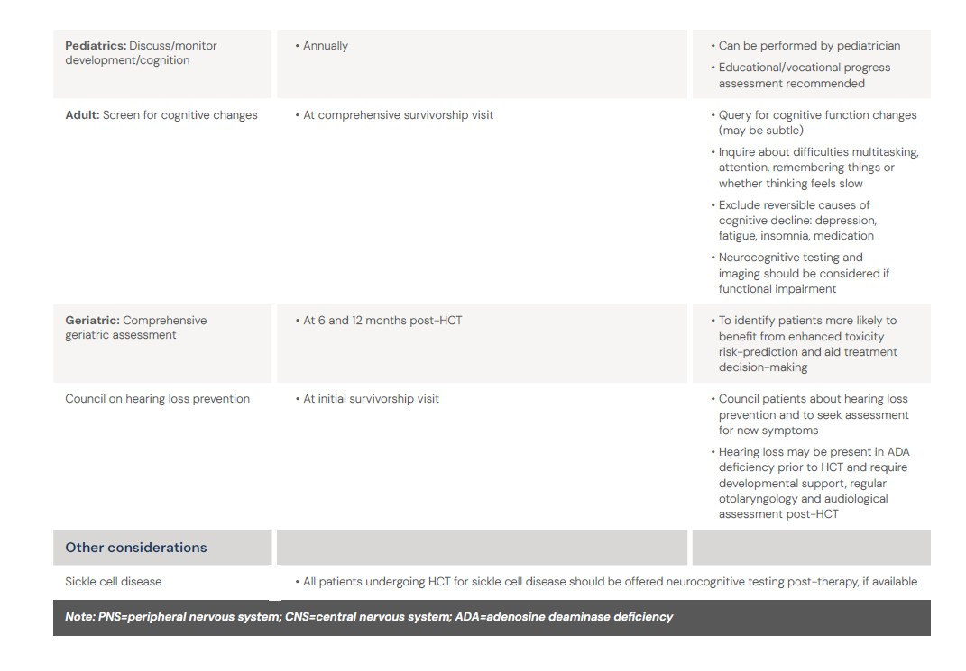

Slide 12
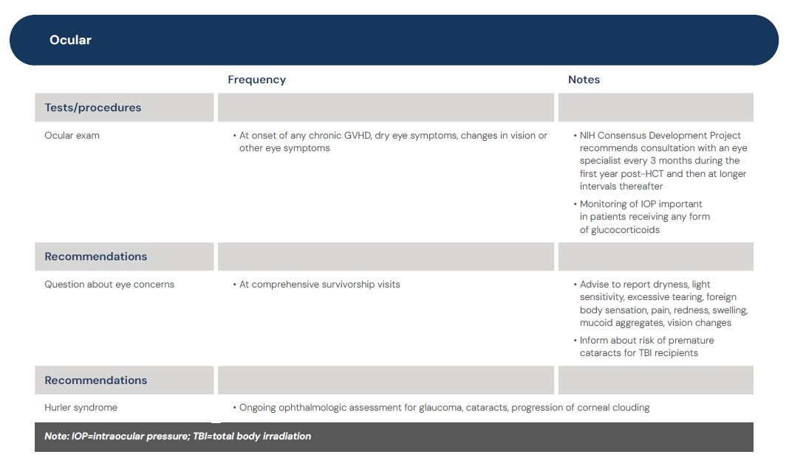

Slide 13
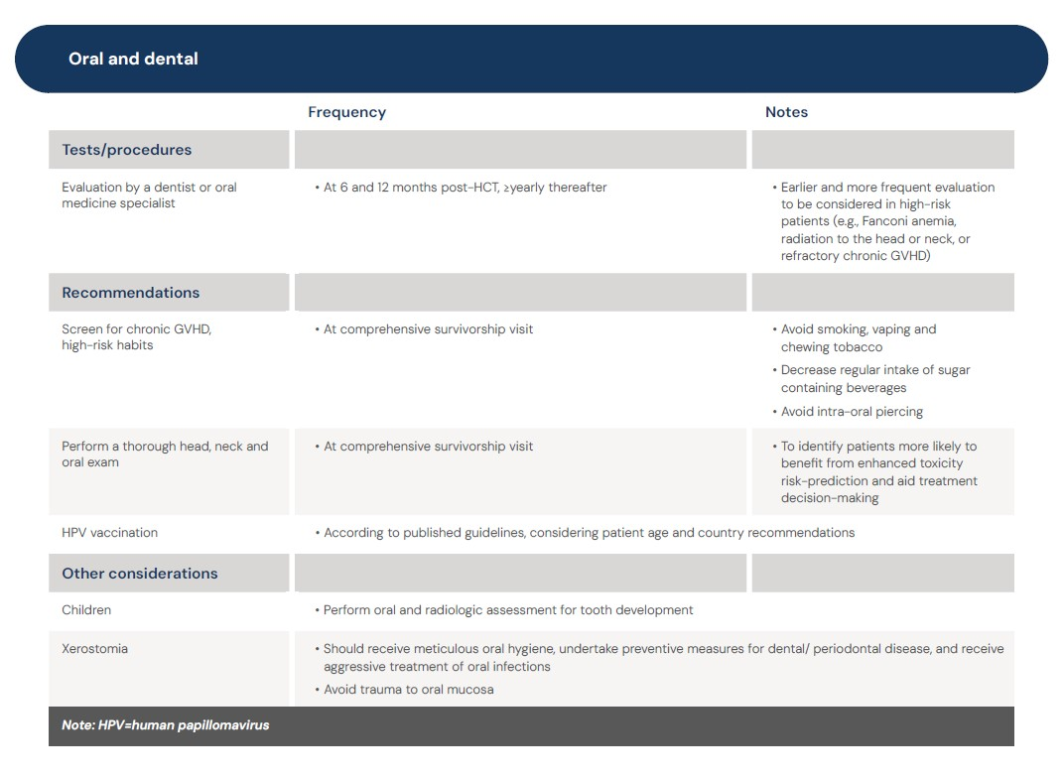

Slide 14
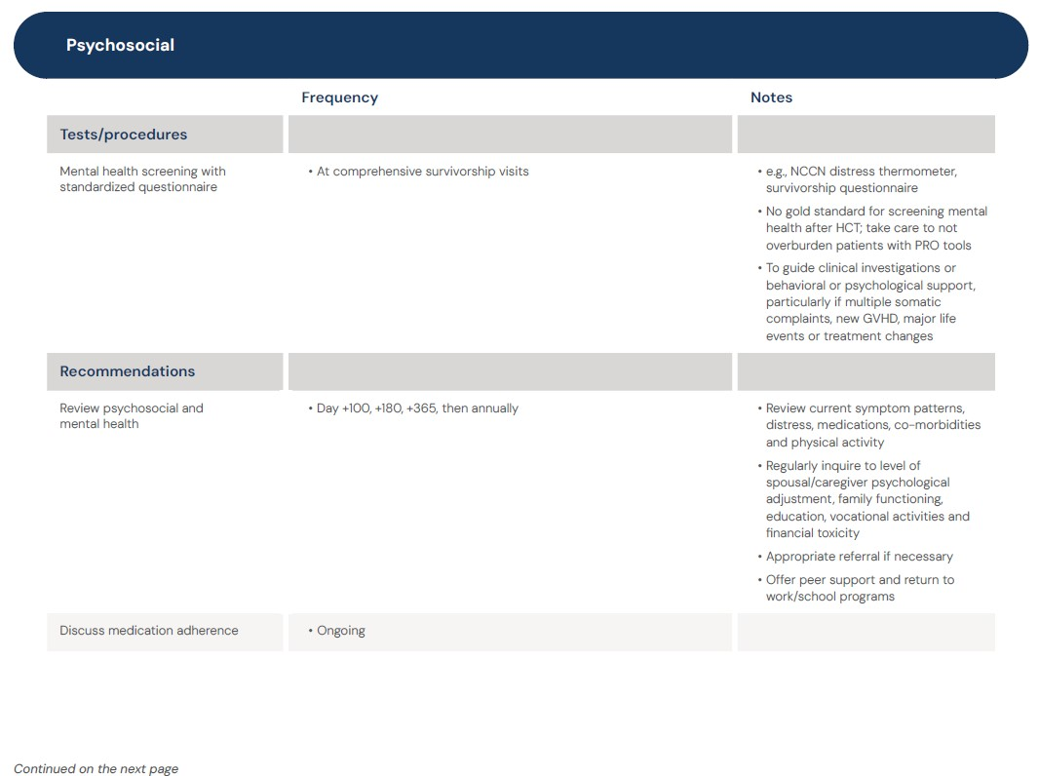

Slide 15
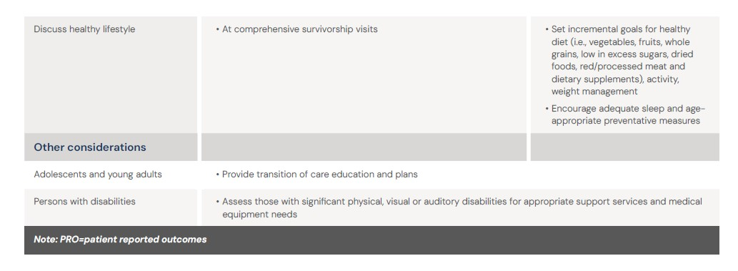

Slide 16
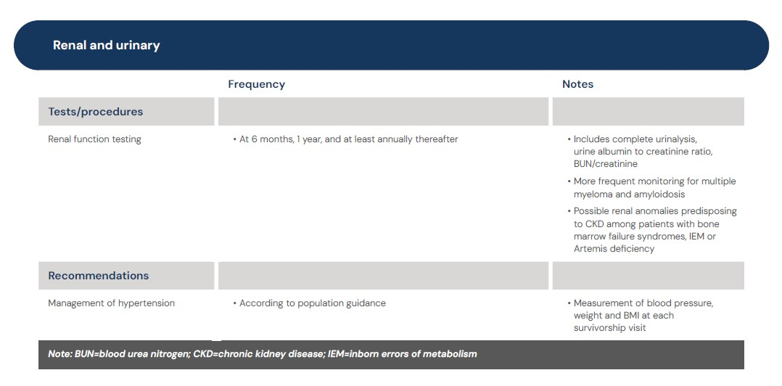

Slide 17
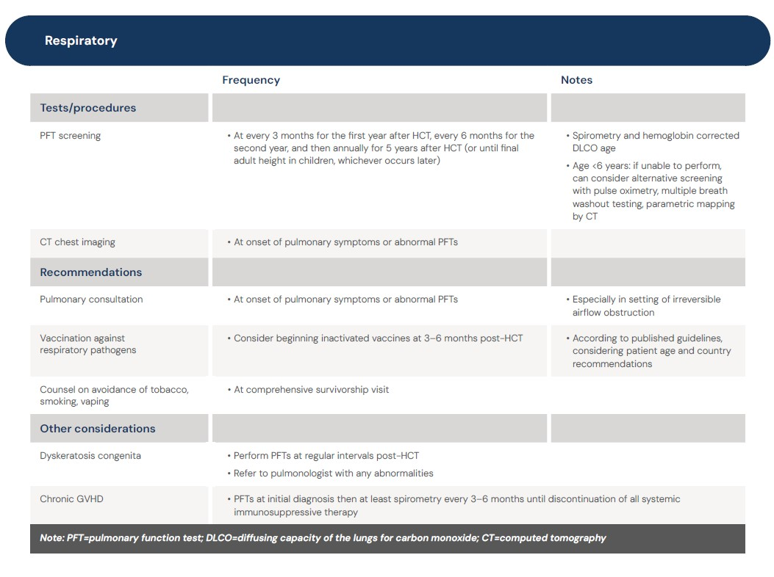

Slide 18
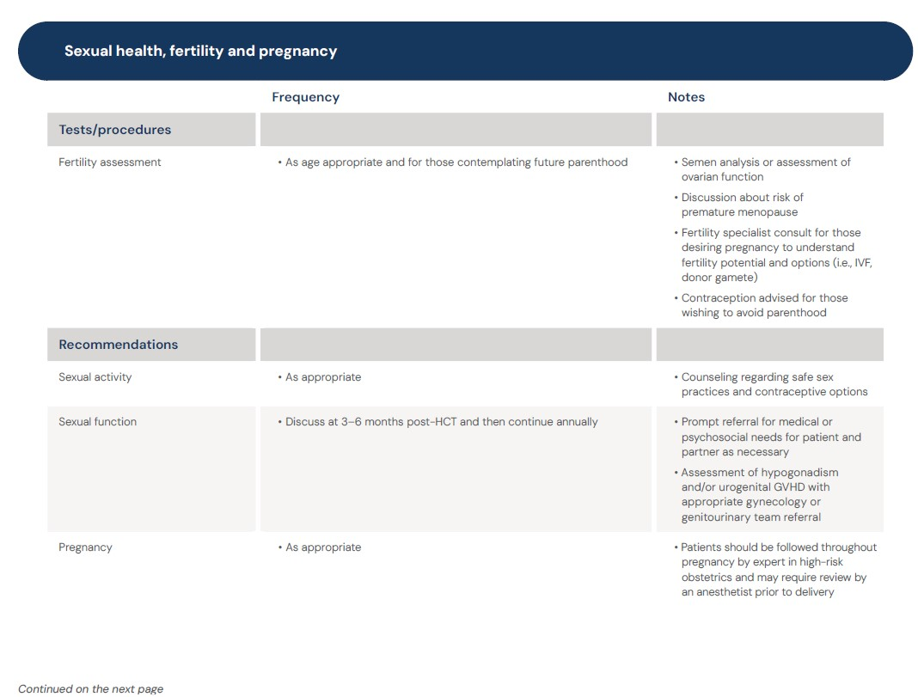

Slide 19
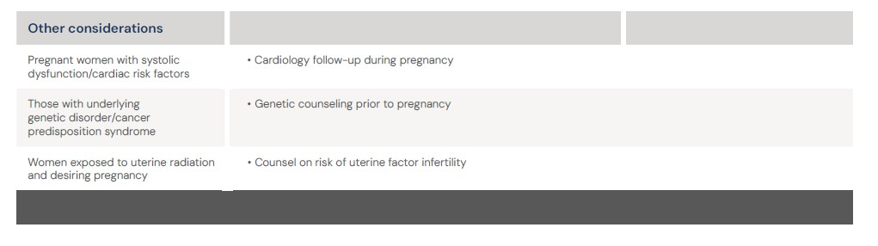

Slide 20
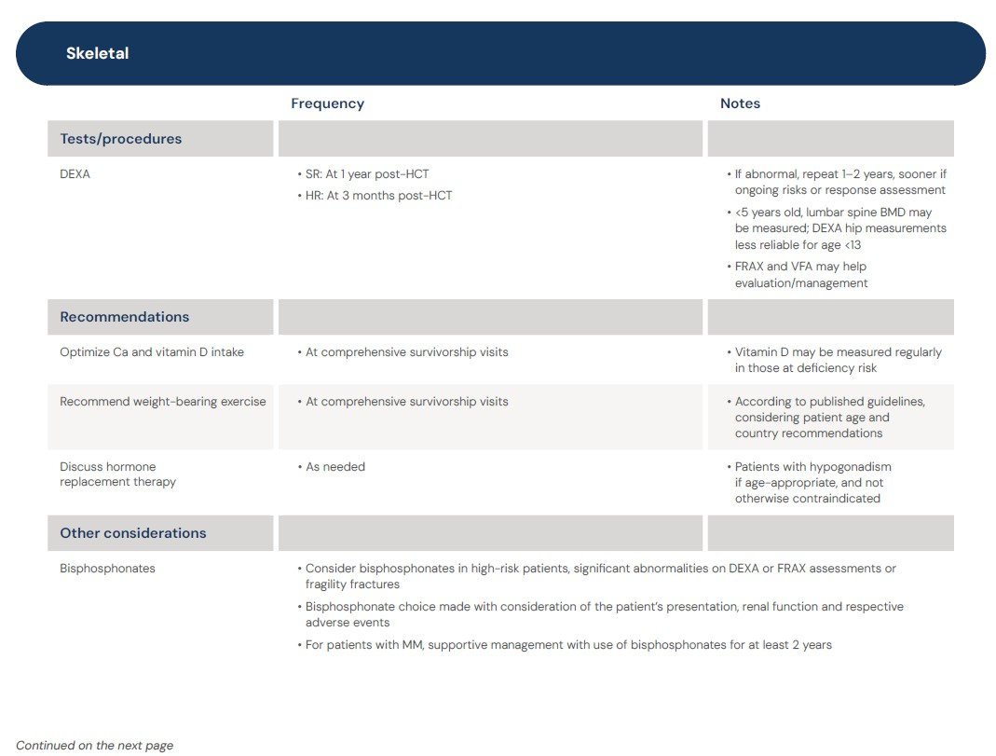

Slide 21
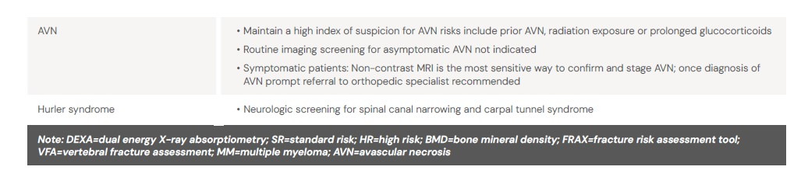

Slide 22
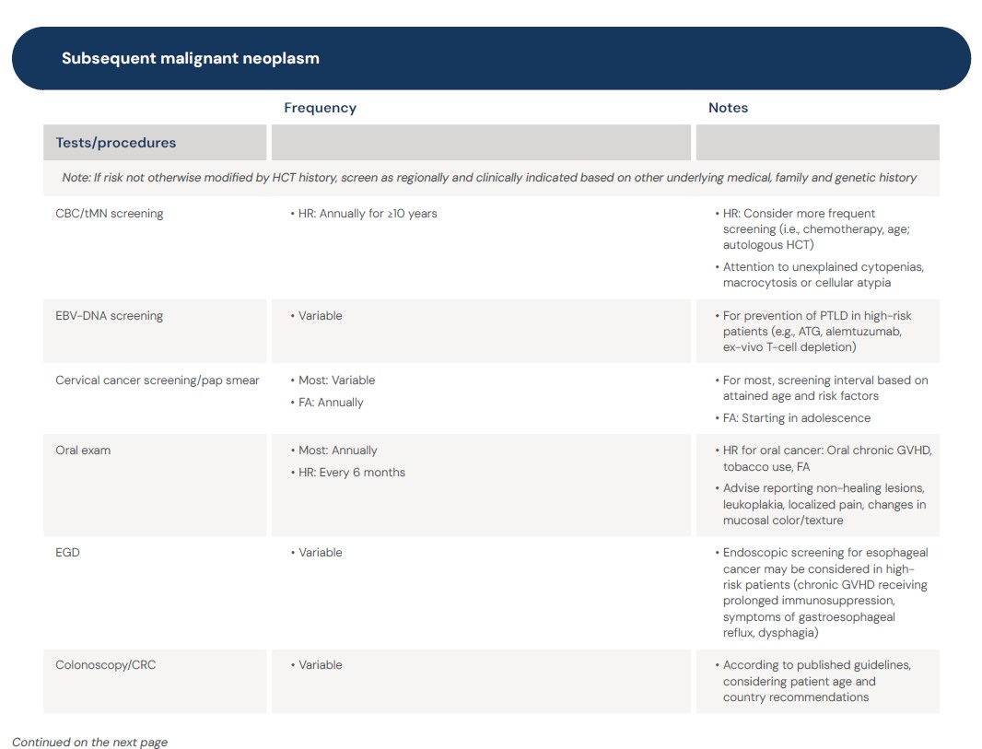

Slide 23
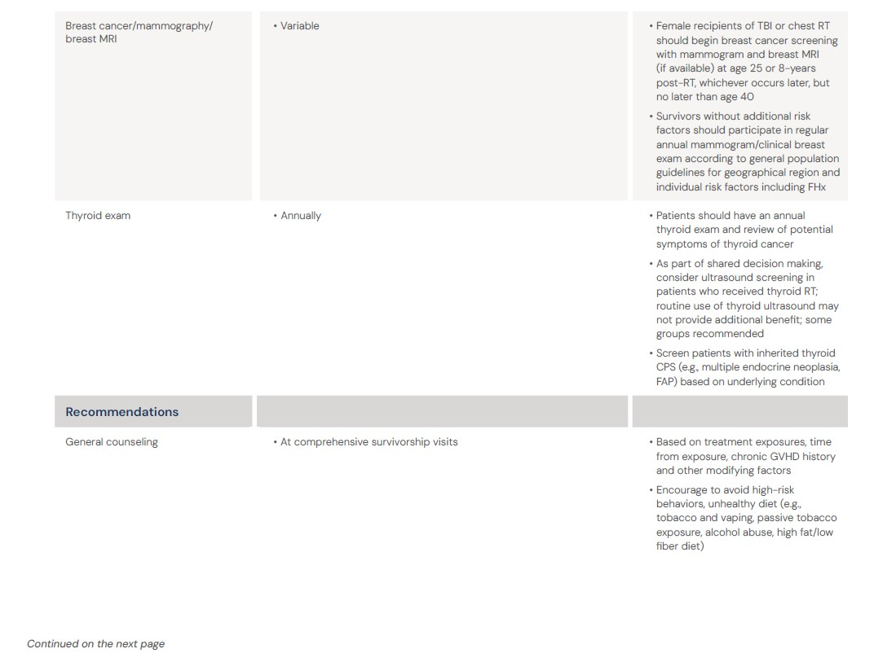

Slide 24
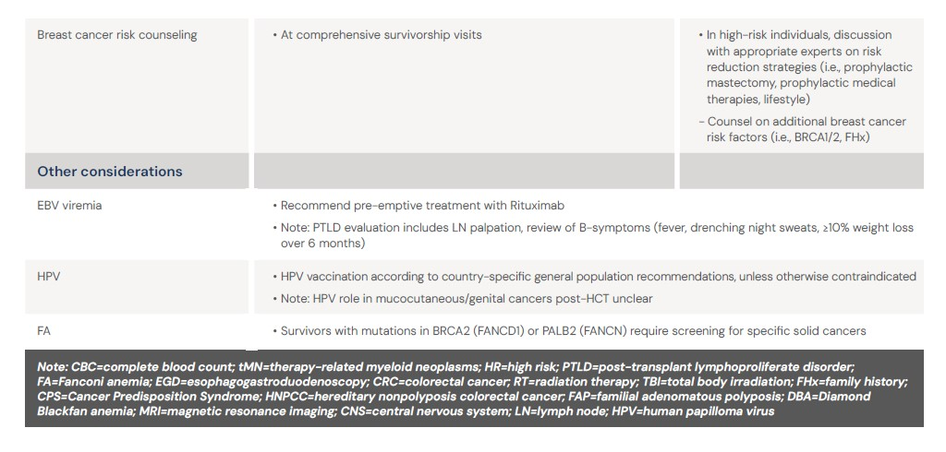

Slide 25
Part 2: Vaccinations

Slide 26
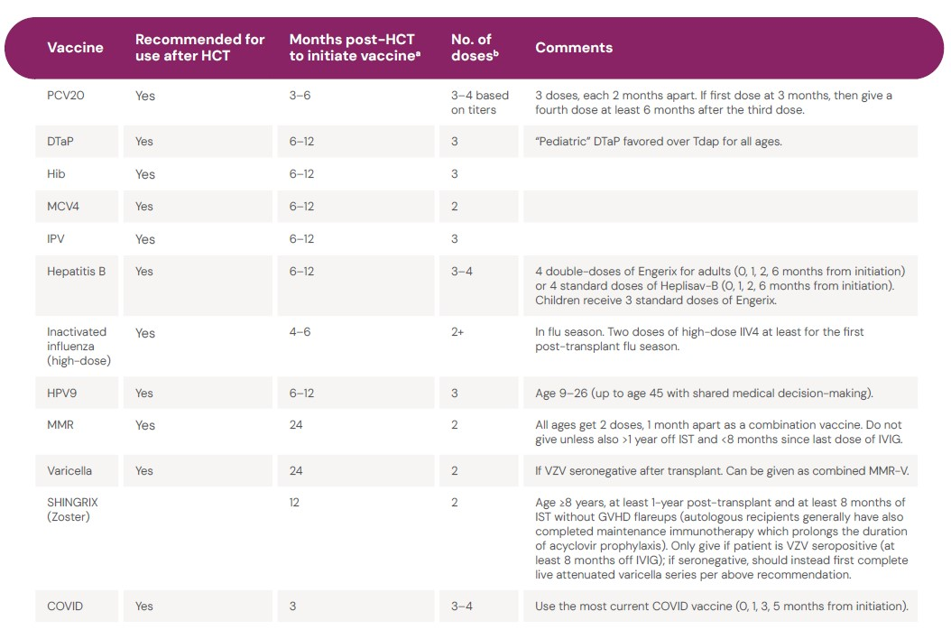

Slide 27
Part 3:
Screening for chronic GVHD

Slide 28
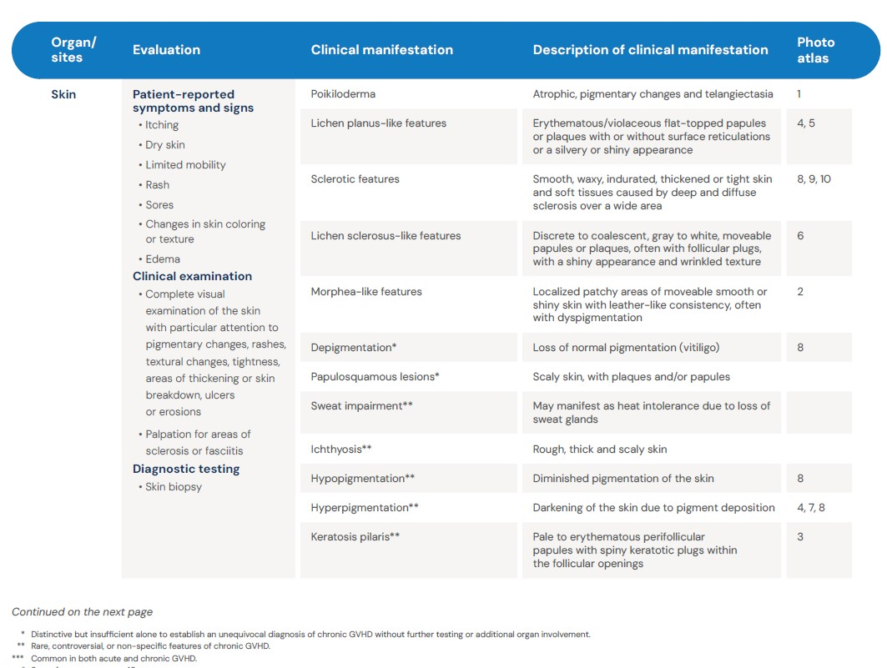
Visit the guidelines app or download the PDF for photo atlas.

Slide 29
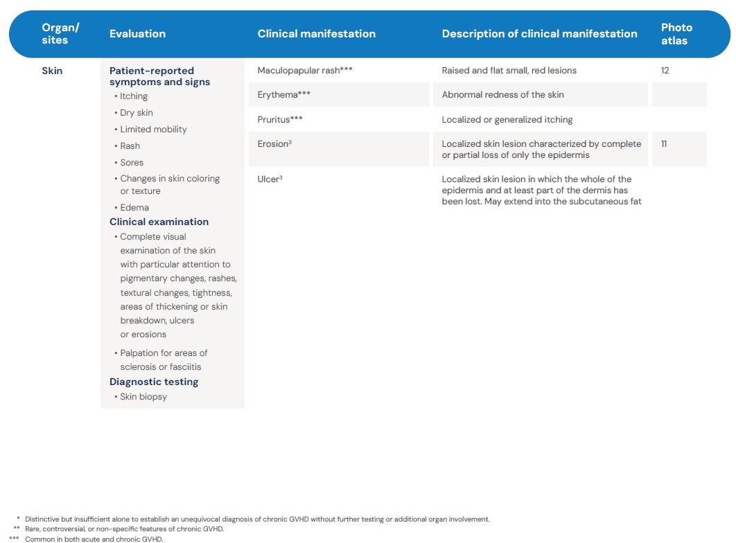
Visit the guidelines app or download the PDF for photo atlas.

Slide 30
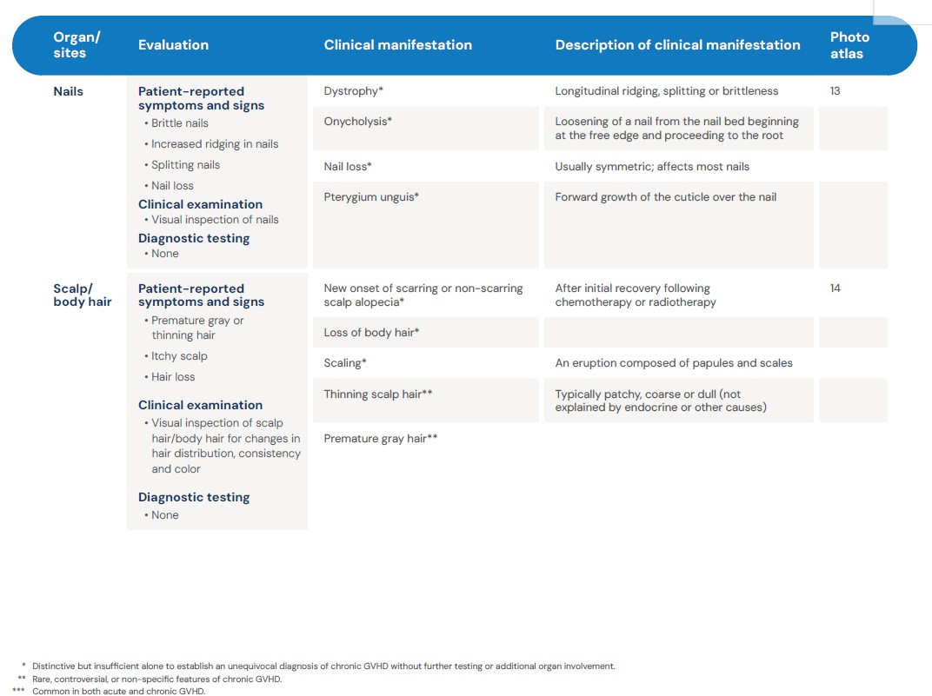
Visit the guidelines app or download the PDF for photo atlas.

Slide 31
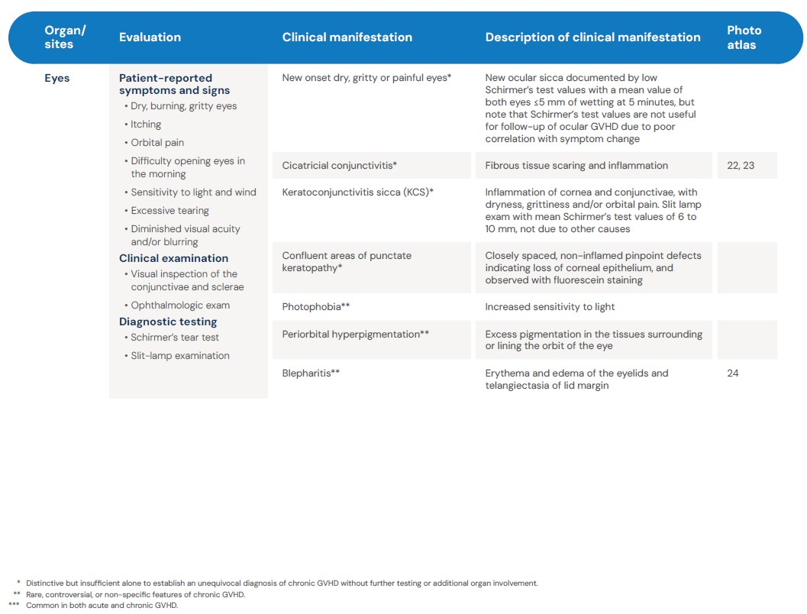
Visit the guidelines app or download the PDF for photo atlas.

Slide 32
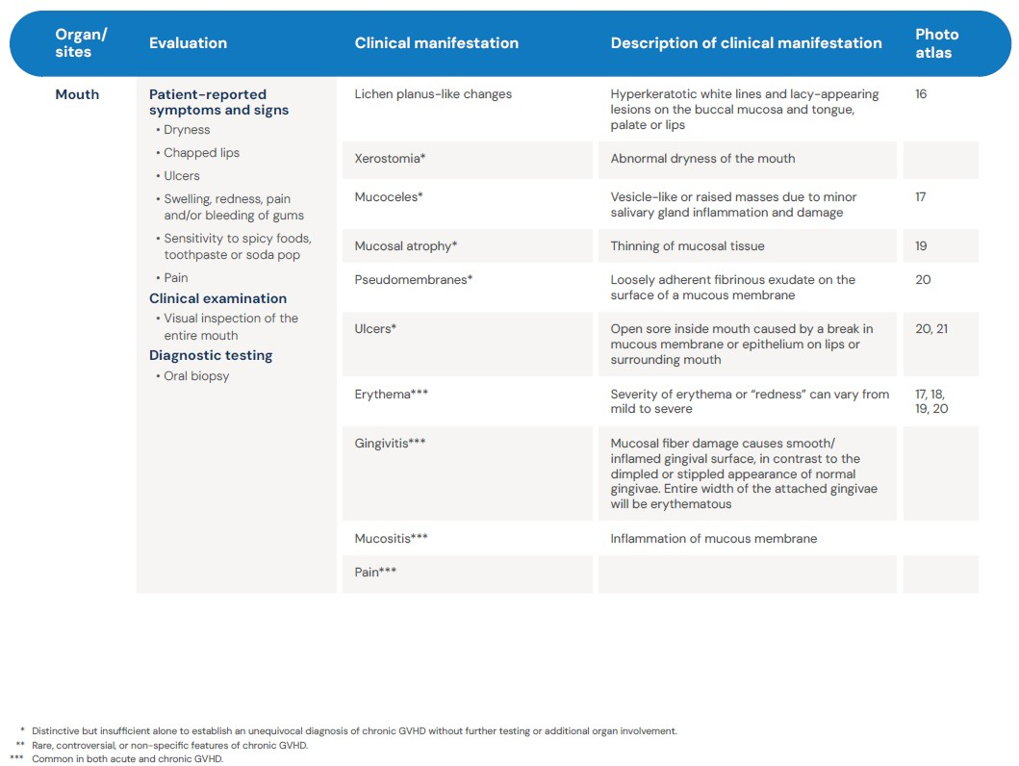
Visit the guidelines app or download the PDF for photo atlas.

Slide 33
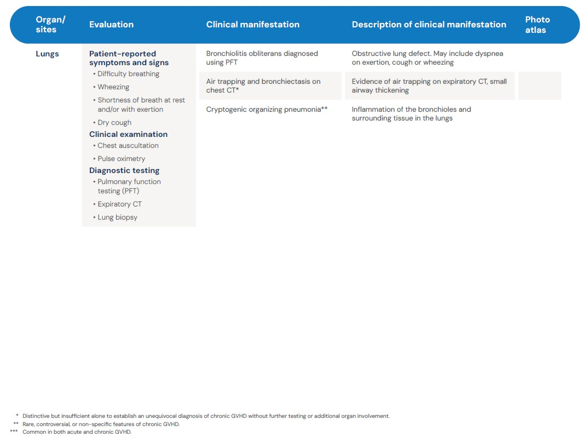
Visit the guidelines app or download the PDF for photo atlas.

Slide 34
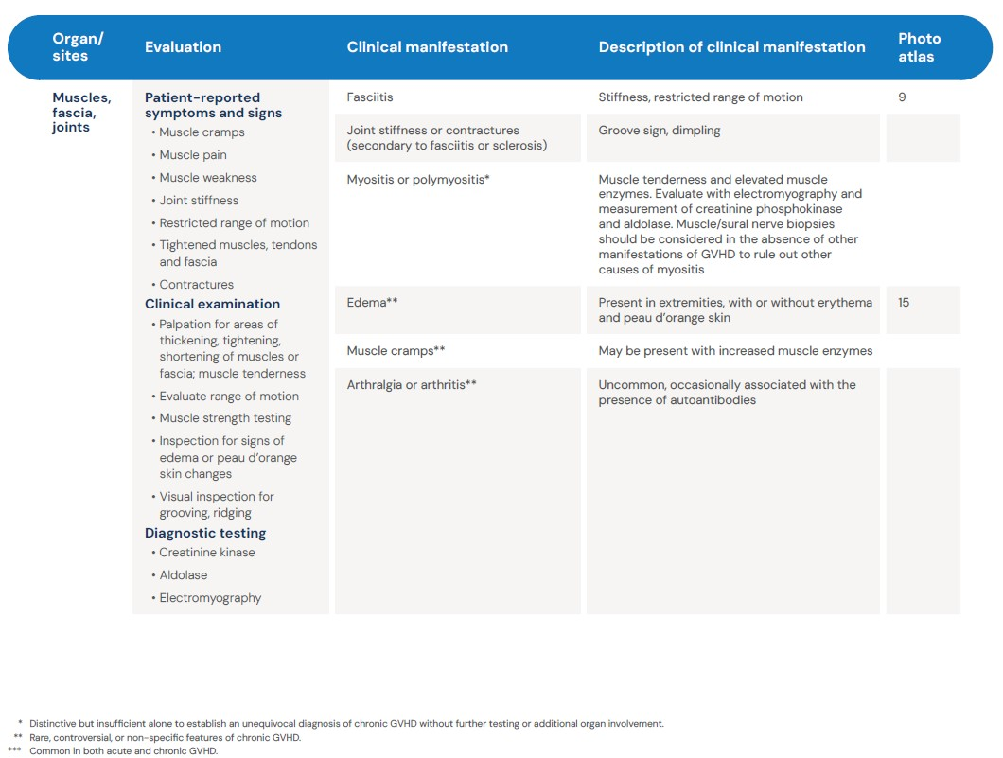
Visit the guidelines app or download the PDF for photo atlas.

Slide 35
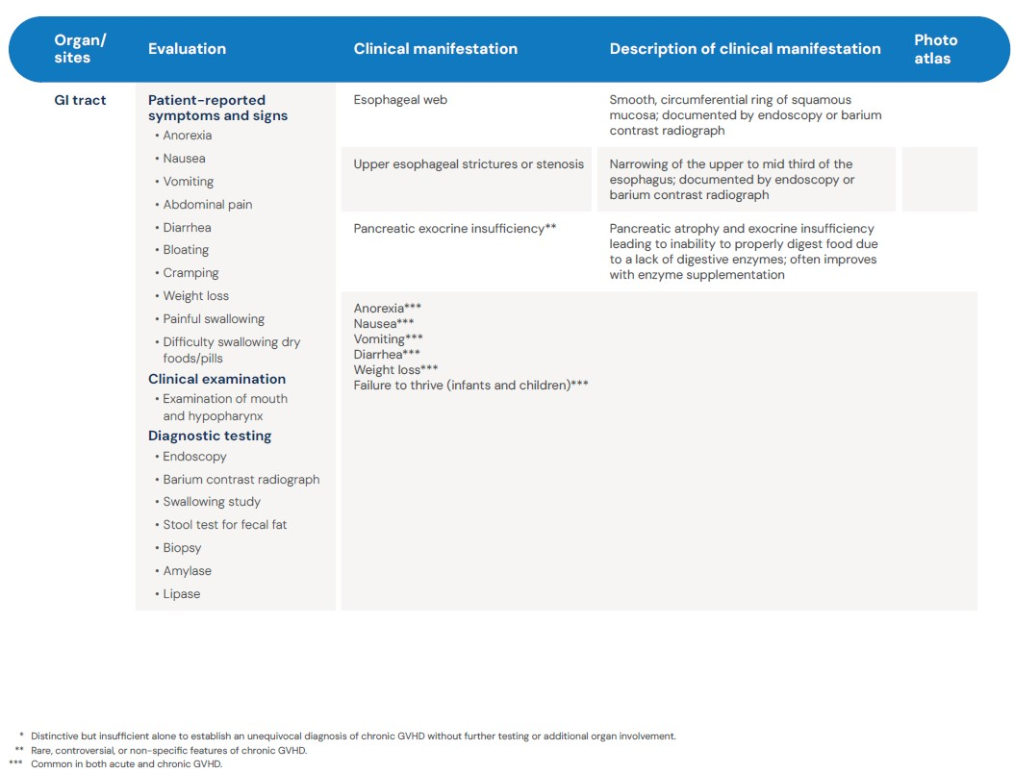
Visit the guidelines app or download the PDF for photo atlas.

Slide 36
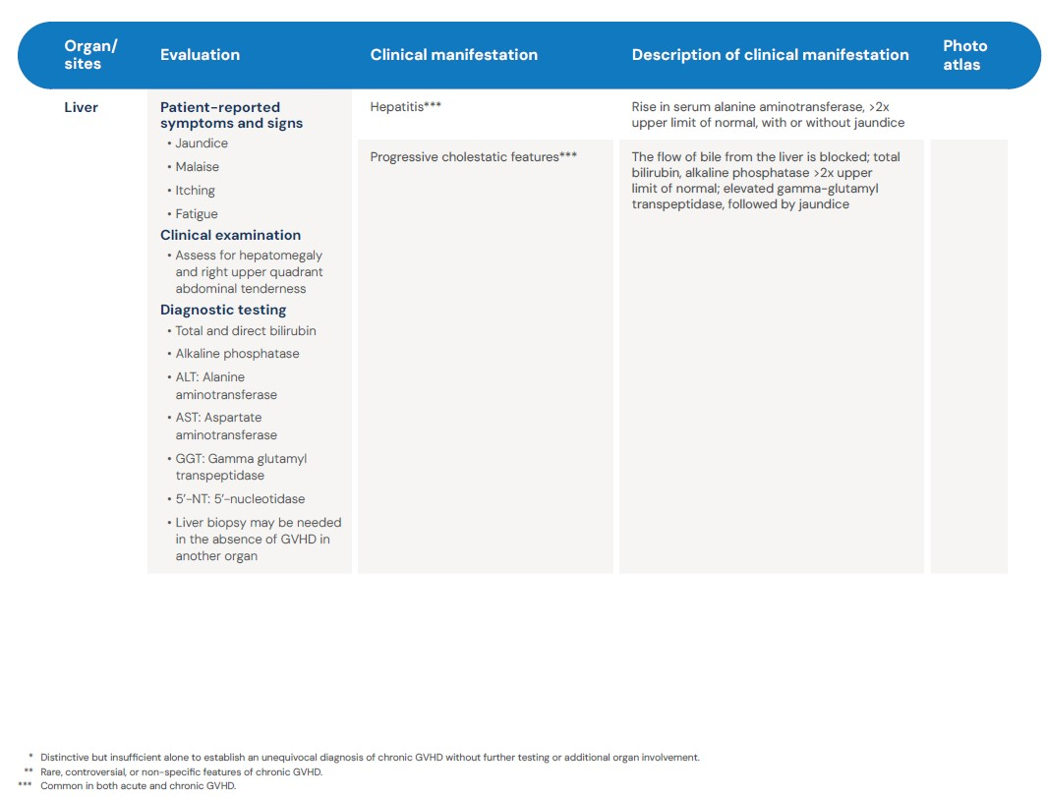
Visit the guidelines app or download the PDF for photo atlas.

Slide 37
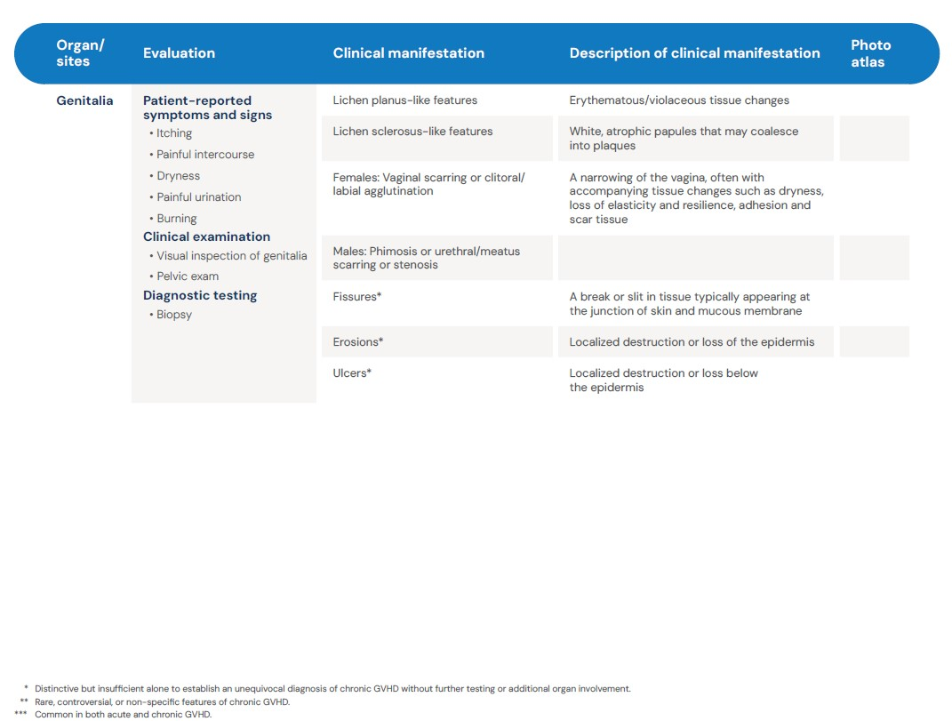
Visit the guidelines app or download the PDF for photo atlas.

Slide 38
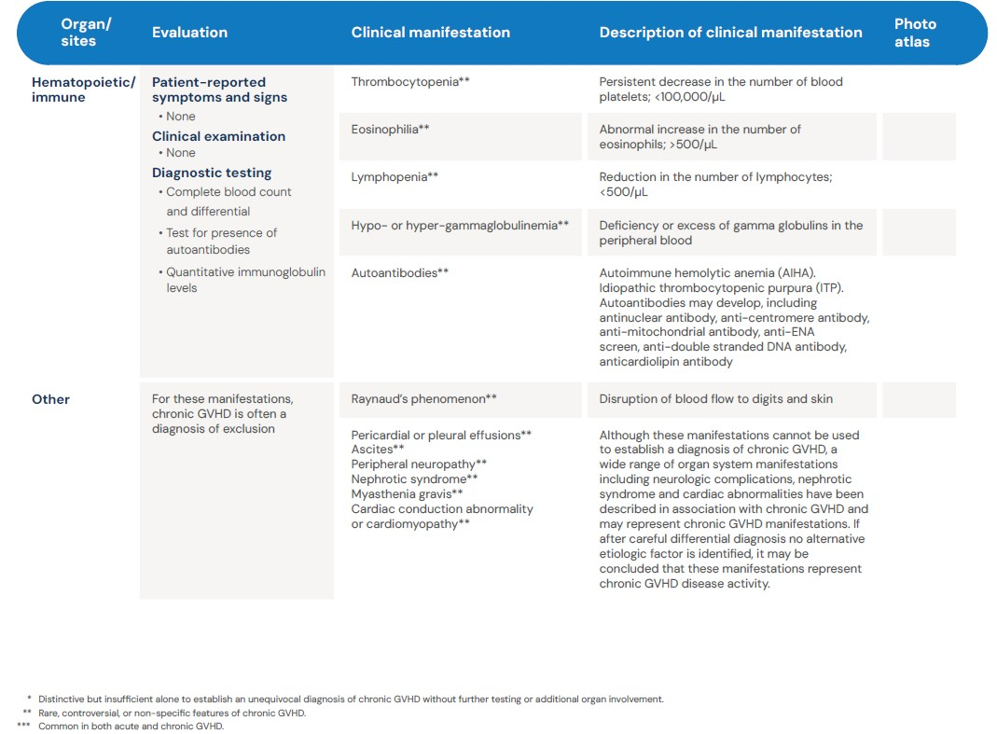
Visit the guidelines app or download the PDF for photo atlas.

